Slide 1
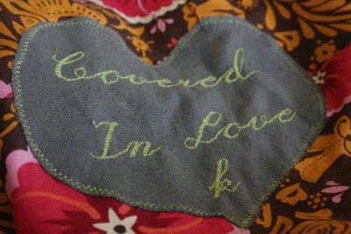
- Adams
School Family
Clothing students in need.

Slide 2
Poor VS. POVERTY
poor
[poor] Show IPA adjective, -er, -est, noun
adjective
1.
having little or no money, goods, or other means of support: a poor family living on welfare.
2.
Law . dependent upon charity or public support.
pov·er·ty
[pov-er-tee] Show IPA
noun
1.
the state or condition of having little or no money, goods, or means of support; condition of being poor. Synonyms: privation, neediness, destitution, indigence, pauperism, penury.
2.
deficiency of necessary or desirable ingredients, qualities, etc. Synonyms: thinness, poorness, insufficiency.

Slide 3
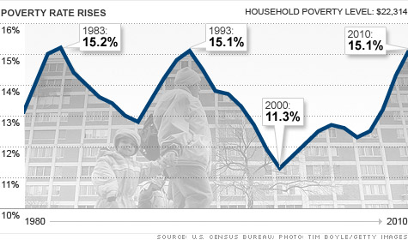
Statistics on Poverty Nation wide

Slide 4
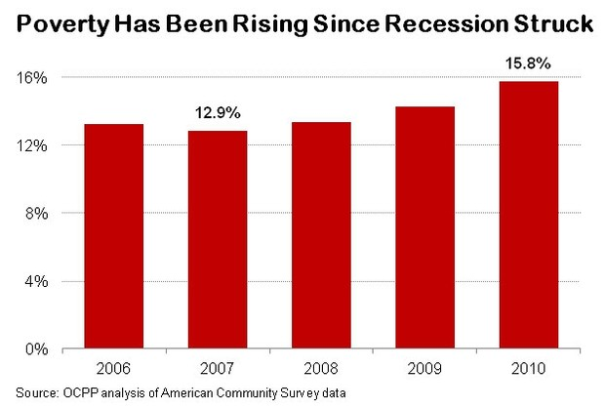
Poverty in Oregon
“Since the start of the recession, Oregon’s poverty rate has risen every year. In 2007, the year prior to the recession, 12.9 percent of Oregonians lived below the poverty line. By 2010, the poverty rate reached 15.8 percent.
During that period, nearly 120,000 more Oregonians joined the ranks of the poor.”
(http://www.ocpp.org/2011/11/09/fs20111109graphic-view-poverty-oregon/)

Slide 5
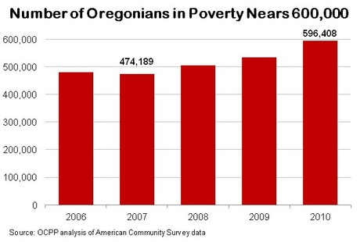
600,000!
“In 2010, about 600,000 Oregonians lived below the federal poverty threshold — an increase of almost 120,000 since the start of the recession.
To put that total in perspective, the number of Oregonians who are officially poor is about twice the population of Oregon’s second and third largest cities, Eugene and Salem, combined (311,303). If Poverty were a city in Oregon, it would be the state’s second biggest city.”
(http://www.ocpp.org/2011/11/09/fs20111109graphic-view-poverty-oregon/)

Slide 6
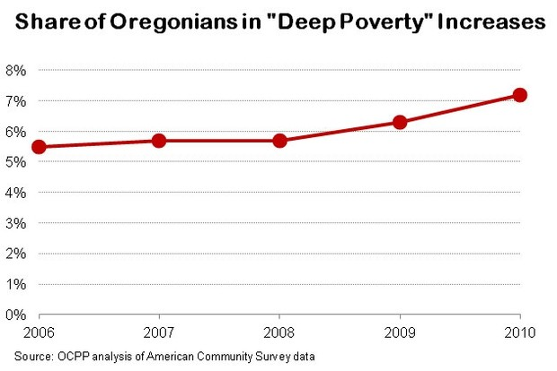
DEEP Poverty
“Deep poverty” — households with income at less than half of the federal poverty threshold — is also on the rise. In 2007, 5.7 percent of Oregonians lived in deep poverty. In 2010 that share grew to 7.2 percent — about 1 in 14 Oregonians.
How deep is deep poverty? In 2010 a family of three would have had to earn less than $8,687 to meet the definition of living in deep poverty.”
(http://www.ocpp.org/2011/11/09/fs20111109graphic-view-poverty-oregon/)

Slide 7
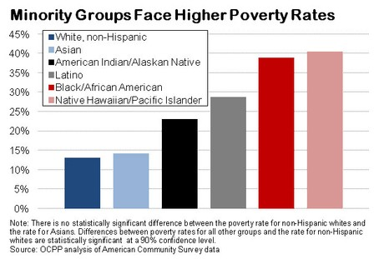
Minority groups in Poverty
“As bad as poverty is for Oregon as a whole, it’s much worse for Oregonians of color. In 2010, the poverty rate for whites (non-Hispanic) in Oregon was 13.1 percent. By contrast, it was 23.1 percent for Native Americans, 28.8 percent for Latinos, 39.0 percent for African Americans and 40.6 percent for Native Hawaiian/ Pacific Islanders. There was no statistically significant difference between the 14.3 percent poverty rate for Asians and the rate for whites.” (http://www.ocpp.org/2011/11/09/fs20111109graphic-view-poverty-oregon/)

Slide 8
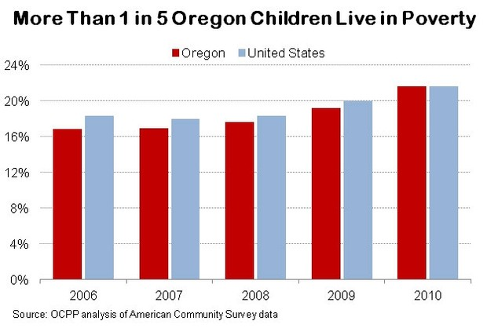
Children (our students) in Poverty
“The share of Oregon children living in poverty has been rising and now exceeds one in five. Specifically, the rate of child poverty in Oregon jumped from 16.9 percent in 2007 to 21.6 percent in 2010.
Oregon’s child poverty rate stood below the national average before the start of the recession but recently caught up to the national level.”
(http://www.ocpp.org/2011/11/09/fs20111109graphic-view-poverty-oregon/)
2011?

Slide 9

We are rich only through what we give, and poor only through what we refuse. - Ralph Waldo Emerson
- Ralph Waldo Emerson

Slide 10

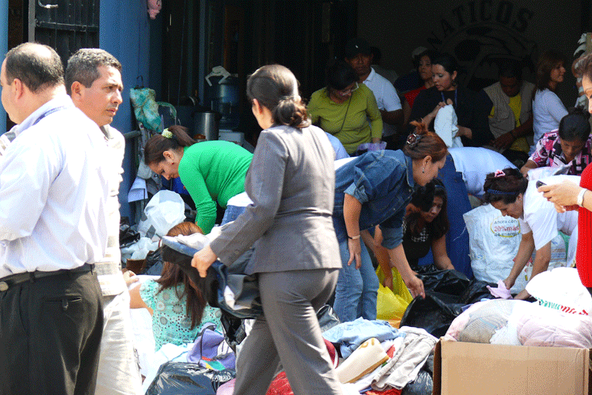
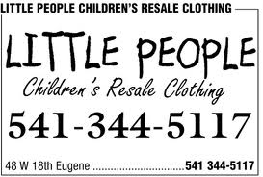

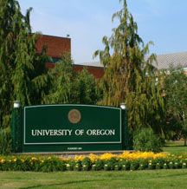
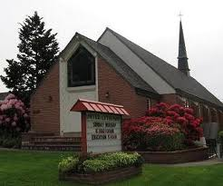
The Stakeholders
The School
The School District
Parents & Community
Local Area Businesses
Local News Media
Local Universities
Local Cultural & Religious Centers
Clothing for students in need, how YOU can help!

Slide 11
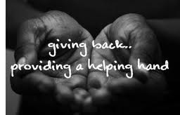
It is our intention as a community school to create a way to provide clothing for the family’s in our community who are in need and attend our schools; to foster a school community that provides care in a manner which allows our students the peace, comfort and freedom to focus on doing their best at school.

Slide 12
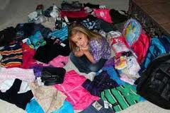
imagine

Slide 13
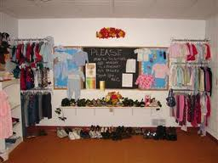
What it could be

Slide 14
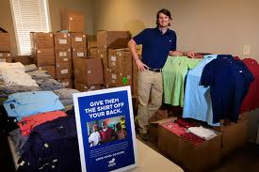
IF WE gave

Slide 15
As a community

Slide 16
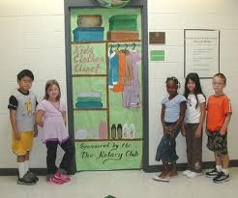
To help them
Sponsored by our community

Slide 17
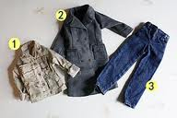
To provide comfort and warmth

Slide 18
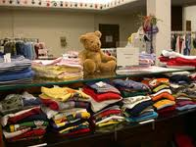
Options for those with so few

Slide 19
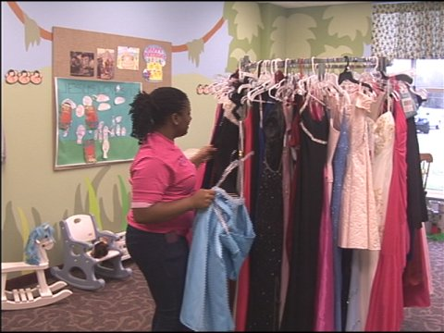
Hope for those with so little

Slide 20
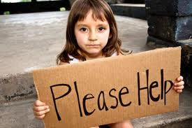
Help for those who need it most

Slide 21
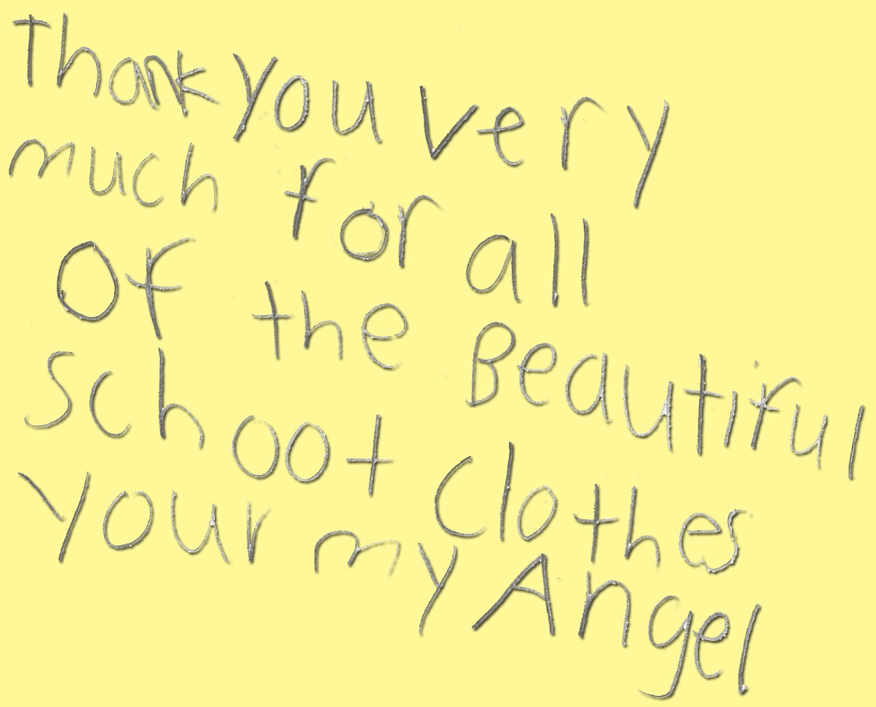
Kindness in words creates confidence. Kindness in thinking creates profoundness. Kindness in giving creates love.
Lao Tzu

